Slide 1
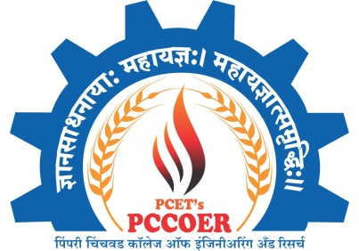
A Presentation on Project Stage -II
“Power converter and control of wind energy
conversion system for maximum power extraction ”
Under the guidance of
Prof. Dr. Rahul G. Mapari
By
Kapil Waghmare (72178178M)
Kiran Thorat ( 72037827D)
Sanket Kale (72037692M)
PCET’S PIMPRI CHINCHWAD COLLEGE OF ENGINEERING AND RESEARCH,
Laxmi Nagar, Ravet, PUNE - 412 101.
ACADEMIC YEAR :2022-23

Slide 2
Outline of Presentation
Content
Introduction
Literature Survey
Gap Identification
Aim/ Problem Statement
Objectives
Methodology
Advantages & Future Scope
Results & Analysis
Appllication
References

Slide 3
Introduction
We know wind energy is one of the most promising renewable energy sources for producing electricity, due to its cost competitiveness compared to other conventional types of energy resources.
Wind power penetration greatly increases in the electric power systems and it is anticipated to keep steady growth in the upcoming years.
To convert wind energy into electrical energy we put a system to work between Wind Energy and Electrical energy. Wind Energy as a input and Electrical Energy is output.
In wind energy conversion system power is converted from pulsating AC to pulsating DC and then DC is converted into AC.
The controllability of the wind turbines becomes more and more important as the power level of the turbines increases. Power electronic, being the technology of efficiently converting electric power, plays an important role in wind power systems.

Slide 4
Literature Review
Sr. No. | Authors and Year of Publication | Title of Paper | Journal Name /Conference name | Methodology Used | Advantages | Limitations/ Drawbacks
1 | Ali M. Eltamaly, Hassan M. Farh (2015) | Smart Maximum Power Extraction for Wind Energy Systems | IEEE International Conference on Smart Energy Grid Engineering (SEGE) | Proposes two effective maximum power point tracking (MPPT) algorithms for two different wind energy conversion systems connected to the grid using permanent magnet synchronous generator.(PMSG) | Maximum Power Extraction done. | Costly and difficulties in practical implementations are due to wind speed measurement.
2 | Syed Naime Mohammad, Nipu Kumar Das, and Saikat Roy (2013) | Power Converters and Control of Wind Energy Conversion Systems | International Conference on Electrical Information and Communication Technology (EICT) | Standard power converter topologies from the simplest converters for starting up the turbine to advanced power converter topologies, where the whole power is flowing through the converter. | This system presents a more realistic modeling of electronics converter used in wind power systems. | The reliability of a wind turbine is critical to extracting the maximum amount energy.

Slide 5
Sr. No. | Authors and Year of Publication | Title of Paper | Journal Name /Conference name | Methodology Used | Advantages | Limitations/ Drawbacks
3 | Lu Jiang Daming Zhang (2021) | Comparison of Different Control of Wind Energy Methods for Maximum Power Point Tracking. | International Conference on Smart Grids and Energy Systems (SGES) | Several DC-DC converter control strategies have been implemented in distributed renewable energy harnessing system for coping with the energy shortageand environmental crisis. | Number of stratergy used; synchronous generator emulation control(SGEC),Polynomial Control Strategy. | Higher requirements of the inductor.
4 | Meyasm Yousefzade, ShahiHedayati Kia,Davood Arab Khaburi Published in (2021) | Emulation of Direct Drive Wind Energy Conversion Systems Based on Permanent Magnet Synchronous Generators | 12th Power Electronics, Drive Systems, and Technologies Conference (PEDSTC) | It consists wind turbine blades, a permanent magnet synchronous generator (PMSG) and a rectifier which is linked to a boost converter. The wind turbine blades, PMSG and bridge diode rectifier models are implemented in a real-time platform which provides a variable DC voltage for a programmable DC power supply. | This will increase the reliability of the system. Moreover, simple structure, high power factor and high efficiency. | The main drawback in the topology using DFIG, is that it needs gears.

Slide 6
Sr. No. | Authors and Year of Publication | Title of Paper | Journal /Conference name | Methodology Used | Advantages | Limitations/ Drawbacks
5 | Mrs.A.Santhi Mary Antony, Dr. D. Godwin Immanuel Published in (2021) | An Overview of Bootstrap Converter for Grid connected Wind Energy Conversion System | 7th International Conferenceon Electrical Energy Systems (ICEES) | In this paper, bootstrap converter topology is implemented by replacing the DC link capacitor between the diode bridge rectifier and voltage source inverter. The voltage ratio of bootstrap circuit is varied by using PWM switching techniques. | It reduces the voltage ripple from the generator side converter, regulates a constant DC voltage to the grid side inverter, sometimes it even functions a filter. | In this system the DC link capacitor is bulky, expensive and regulated voltage level cannot be changed.
6 | M. S. Hosaain Lipu, MD. Sazal Miah , Hanisf MD Saad, MD. Sultan Mahmud (2021) | Artificial Intelligence Based Hybrid Forecasting Approaches for Wind Power Generation | IEEE AI Based Hybrid Forecasting Approaches for Wind Power Generations | AI-based hybrid approaches for wind power forecasting emphasizing classification, structure, strength, weakness and performance analysis. | Simple structure, flexible and easy to program, quick learning operation. | Slow convergence speed, quite sensitive to noisy data, slow training operation.

Slide 7
Sr. No. | Authors and Year of Publication | Title of Paper | Journal /Conference name | Methodology Used | Advantages | Limitations/ Drawbacks
7 | Alper nabi akpolat, Erkan dursan, Ahmet emin kuzucuoglu ( 2021) | Deep Learning Aided Sensorless Control Approaches for PV Conveters in DC Nanogrids | IEEE Deep Learning-Aided Sensorless Control Approach for PV Converters in DC Nanogrids | For stability, reliability, efficiency the deep learning aided-sensorless control approach is adopted. | High accuracy, utilizing real datasets without generating artificial data, and complying with the real application data, DL overcome multiple key developments. | Lower efficiency, higher implementation cost,more complicated and lower reliability

Slide 8
Gap Identification / Finding from Survey
From the literature survey following gaps are identified :
From research papers we found that the old system is costly and difficulties in practical implementations are due to wind speed measurement.
The reliability of a wind turbine is critical to extracting the
maximum amount energy.
The main drawback in the topology is higher requirements of the inductor.
Lower efficiency, higher implementation cost,more complicated and lower reliability

Slide 9
Problem Statement
Aim :
“ To extract maximum power by using Power converter and control of wind energy conversion system”
For maximum power extraction, we use PWM technique. In wind energy conversion systems (WECSs) SPWM is use for Operation.
The system controller is simple, low cost, and robust.
The proposed method can have higher efficiency.

Slide 10
Objectives
The objectives of the proposed projects are :
To extract maximum power.
To achieve better efficiency.
To minimize the harmonics.
To stabilize the output.
To automate the system based on availability of sufficient energy either from wind or grid.

Slide 11
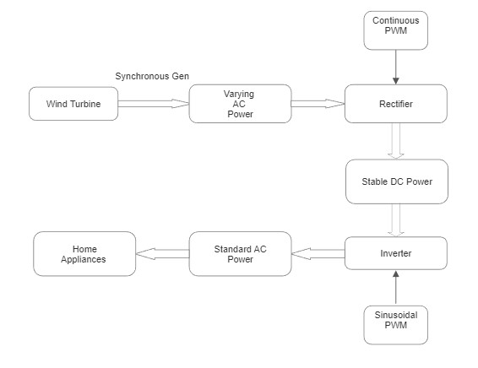
Proposed Methodology :Block Diagram
Block Diagram

Slide 12
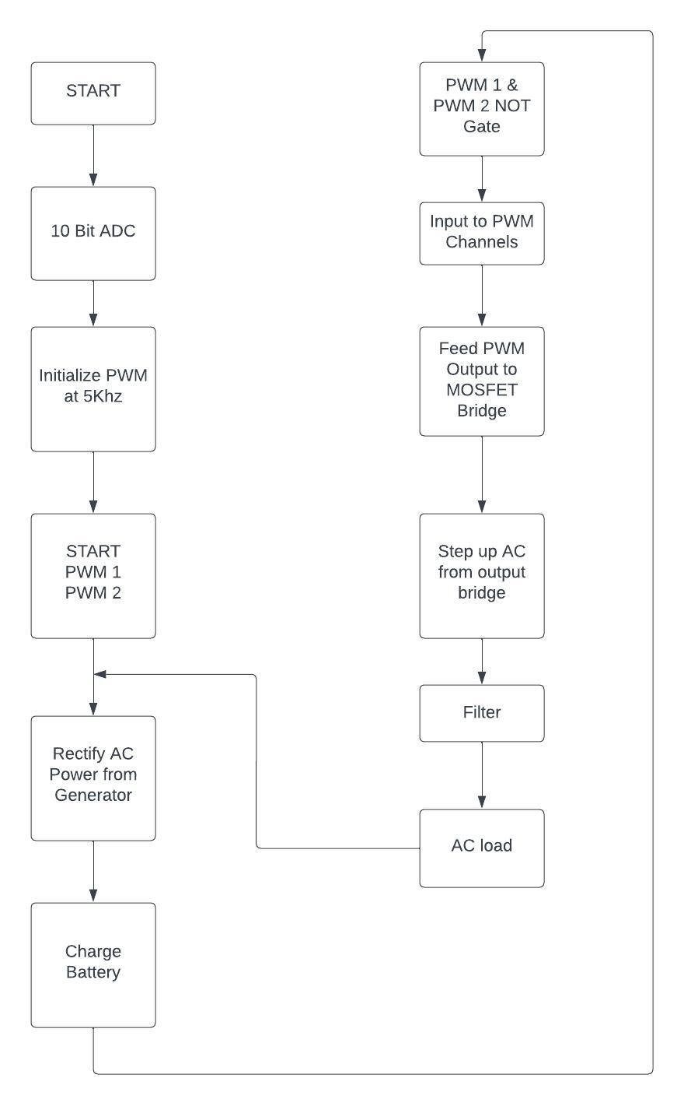
Flow Chart

Slide 13
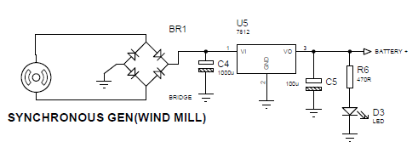
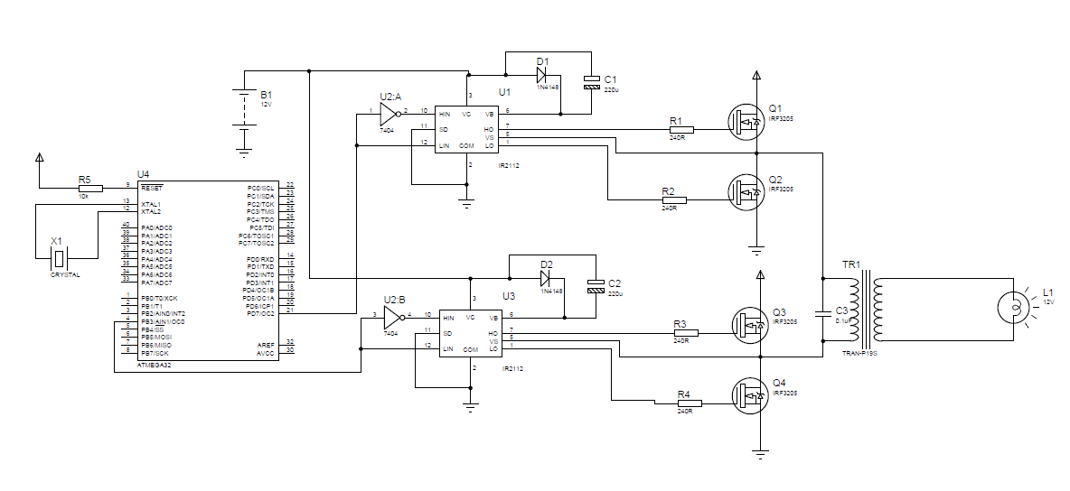
Main Circuit Diagram

Slide 14
Figure : Schematic of a Single Phase Full-Bridge Inverter and its waveform.
Figure: a) bipolar and b) unipolar modulation scheme

Slide 15
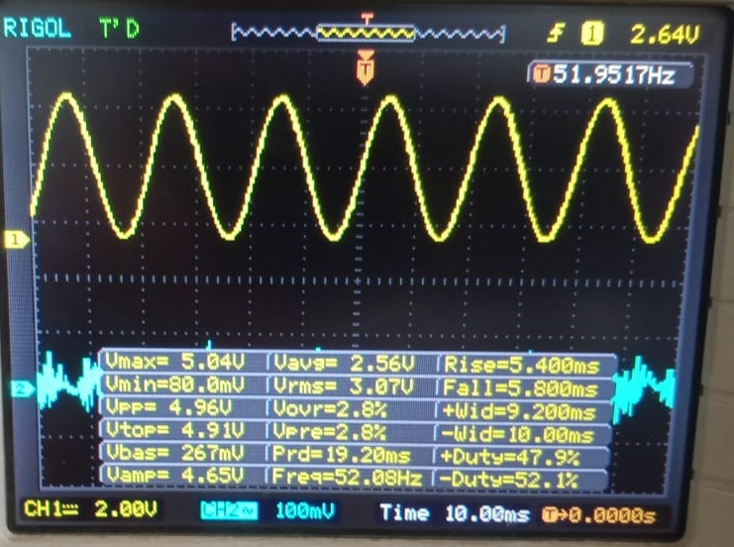
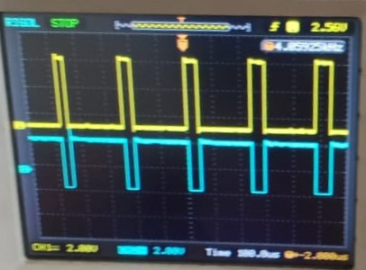
OUTPUT OF WIND TURBINE
SPWM WAVEFORM

Slide 16
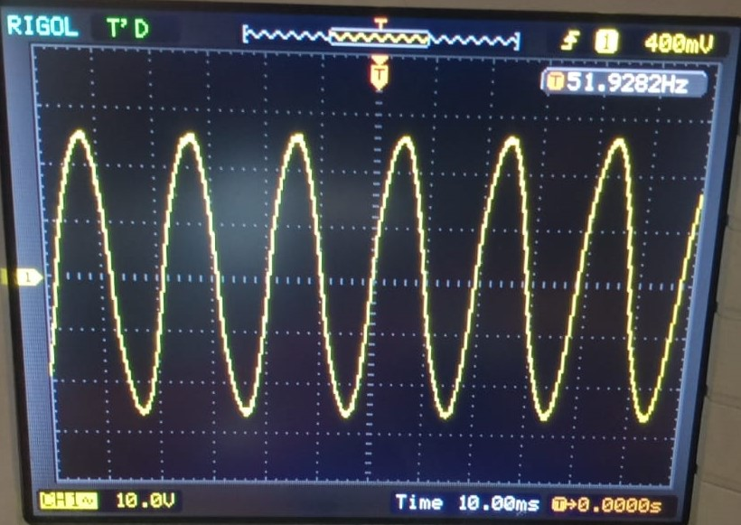
OUTPUT OF SYSTEM (AC)

Slide 17
Advantages: - 1. Maximum Power Extraction done. 2. Simple structure. 3. flexible and easy to use, quick learning operation. 4. High accuracy, utilizing real datasets.
Future Scope : -
1. Artificial Intelligence and Machine Learning.
2. Smart Grid Integration.
3. Modular Design.
4. Multi-Level Converters.
5. Voltage Regulation.

Slide 18
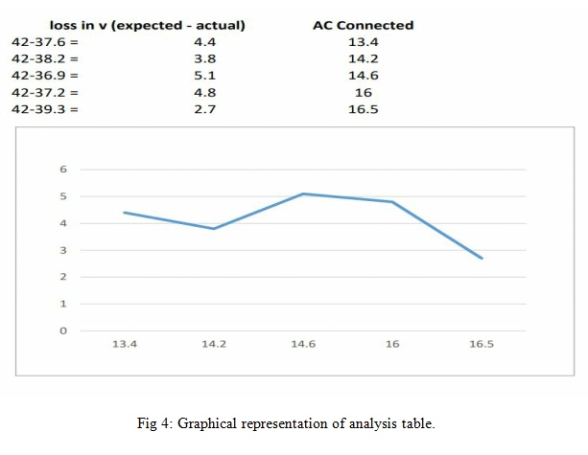
Result and Analysis
Sr. No. | ACGenerated | AC-DC(Loss 0.8 V) | Battery(Stabilize) | DC-AC(Loss 0.8 V) | Step-upAC
1 | 13.4 | 12.7 | 12 V | 11.1 | 37.6 V
2 | 14.2 | 13.6 | 12 V | 11.3 | 38.2 V
3 | 14.6 | 13.8 | 12 V | 10.6 | 36.9 V
4 | 16.0 | 15,3 | 12 V | 10.9 | 37.2 V
5 | 16.5 | 15.8 | 12 V | 11.2 | 39.2 V
Analysis Table.

Slide 19
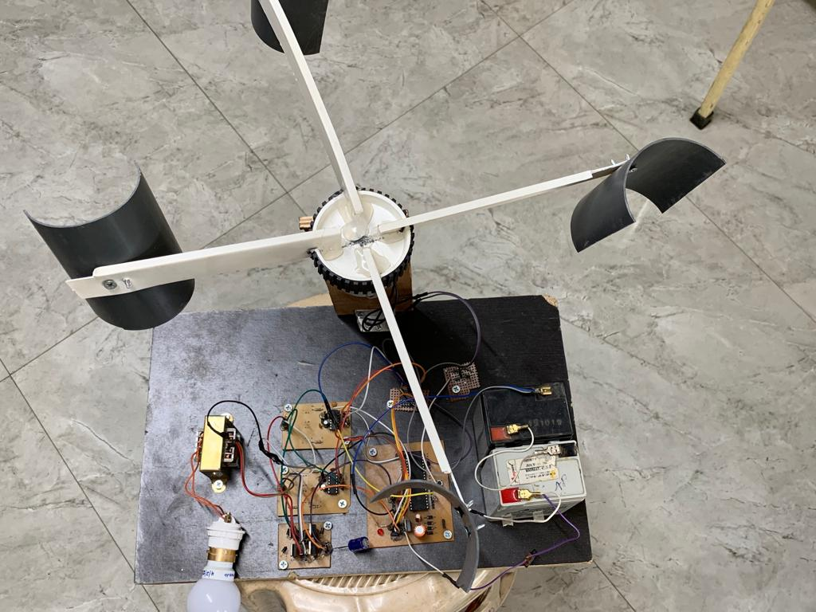
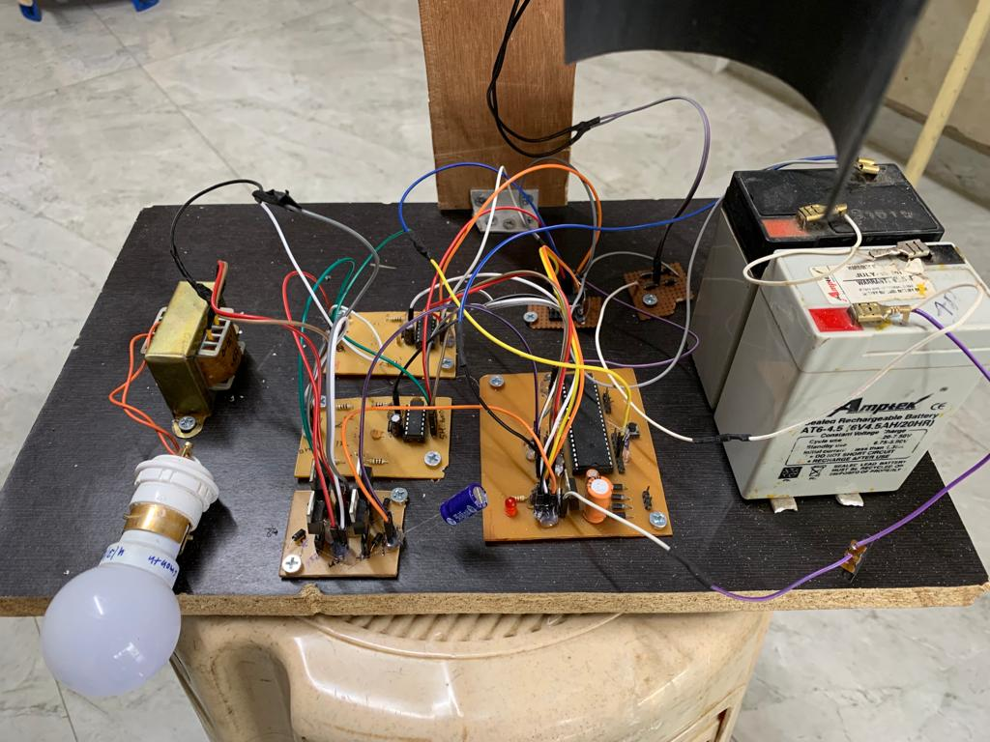

Slide 20
Applications
Applications the proposed system can be employed at variety of applications such as :
Electrical energy production: With wind turbines, the wind's kinetic energy can be transformed into mechanical energy and this, in turn, into electrical energy.
Pumping water: Wind energy can be used to extract water from the ground using wind pumps, which are turbines capable of pumping up to six hundred liters per hour, which is enough to meet the needs of a small farm.
Home appliances: We can use power for home appliance.
Renewable hydrogen: Wind energy is used to produce the continuous electrical current that the needed to produce renewable hydrogen.

Slide 21
Outcome:
Research Paper Publication:
Research paper Has Been Published in Dogo Rangsang.
(UGC CARE JOURNAL)
CopyRight:
Copyright filed.(Diary Number: 23202/2022-CO/L)

Slide 22
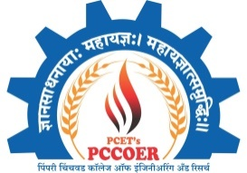
References
Journal Paper-
Ali M. Eltamaly,Hassan M. Farh IEEE International Conference on Smart Energy Grid Engineering (SEGE)(2015)
Syed Naime Mohammad,Nipu Kumar Das, and Saikat Roy International Conference on Electrical Information and Communication Technology (EICT)(2013)
Lu Jiang Daming Zhang(2021) International Conference on Smart Grids and Energy Systems (SGES)(2021)
Meyasm Yousefzade, ShahiHedayati Kia,Davood Arab Khaburi 12th Power Electronics, Drive Systems, and Technologies Conference (PEDSTC) (2021)

Slide 23
References
Journal Paper-
5. Mrs.A.Santhi Mary Antony, Dr. D. Godwin Immanuel 7th International Conference on Electrical Energy Systems (ICEES)
(2021)
6. M. S. Hosaain Lipu, MD. Sazal Miah , Hansif MD Saad, MD. Sultan Mahmud IEEE AI Based Hybrid Forecasting Approaches for Wind Power Generations (2021)
7. Alper nabi akpolat, Erkan dursan, Ahmet emin kuzucuoglu IEEE Deep Learning-Aided Sensorless Control Approach for PV Converters in DC Nanogrids(2021)

Slide 24
THANK YOU..

